Slide 1
TIRA Beauty
UNDER GUIDANCE OF MRS.VAISHALI SONANIS MAM
By Ravada Eswari Lakshmi Priyanka

Slide 2
INTRODUCTION
Tira is a popular e-commerce website in India that specializes in beauty and lifestyle products ,which was launched in 2023.
It offers a wide range of products across various categories, including skincare, haircare, makeup, fragrances, and more.
Tira features a wide range of products from popular international and domestic brands.
Key Features:
Wide Product Range
Brand Variety
Search and Filter Options
Secure Payment Options

Slide 3
RESPONSIBILITIES
ANALYZE EACH MODULE AND SUB-MODULE
CREATE TEST PLAN ON EACH MODULE
WRITING AND EVALUATING TEST CASES
PERFORMI BOTH MANUAL AND AUTOMATION TESTING
CREATE DEFECT REPORT

Slide 4
OVERVIEW
WHAT IS TIRA BEAUTY?
BEAUTY AND WELLNESS E-COMMERCE PLATFORM: TIRA IS AN ONLINE PLATFORM THAT SPECIALIZES IN BEAUTY AND LIFESTYLE PRODUCTS.
WIDE RANGE OF PRODUCTS: OFFERS PRODUCTS ACROSS VARIOUS CATEGORIES, INCLUDING: - SKINCARE - HAIRCARE - MAKEUP - FRAGRANCES - AND MORE
POPULAR BRANDS: ALLOWS USERS TO BROWSE AND PURCHASE PRODUCTS FROM POPULAR BRANDS.

Slide 5
MODULES
MODULE 1: MY ACCOUNT
Checked all the functionalities including personal details, address, orders
MODULE 2: MY BAG
Checked all the functionalities including max and min quantity of products. Adding and removing products
MODULE 3:HELP CENTER
Checked all the functionalities including required fields and uploading images
MODULE 4: MENU
Checked all the functionalities including brands, offers, top shelf, for you, tira red
MODULE 5: MULTI- SEARCH
Checked the search functionalities by giving multiple search items

Slide 6
MODULE 6: GIFTS
Checked all the functionalities including for her, for him, occasion and free gifts too.
MODULE 7: MY WISHLIST
Checked all the functionalities whether products are added and removed from Wishlist and further added to cart
MODULE 8: SUBSCRIPTION
Checked all the functionalities including mail id fields and save button to get notify from Tira.
MODULE 9: SOCIAL MEDIA
Checked all the functionalities like WhatsApp, Instagram and Facebook.
MODULE 10: FAQ’s
Checked all the functionalities of all the queries and related responses.

Slide 7
DEFECTS
DEFECT 1 :
Product is active in catalog, but shows 'Product not found' in My Bag with incorrect count
DEFECT 2 :
Without login and email verification, the web is accepting invalid email IDs and allowing users to raise tickets for queries in Help Center module.

Slide 8
DEFECT IDENTIFIER:- B_001
Defect identifier :- B_001
Ø Defect summary :- Product is active in catalog, but shows 'Product not found' in My Bag with incorrect count i.e.; Expected output: either out of stock or not deliverable to Pin code . Actual output: product not found
Ø Test Id :- TC_001
Ø Test case name :- TC__inactive__prod
Ø Module name :- My Bag
Ø Reproducible :-
Ø Severity :- medium
Ø Priority :- medium
Ø Raised by :- Eswari R.L.P
Ø Assigned to :- developer Team lead
Ø Date of assignment :- 08-08-2025
Ø Status :- pending
Ø Fixed by :- developer
Ø Date of fixing :-

Slide 9
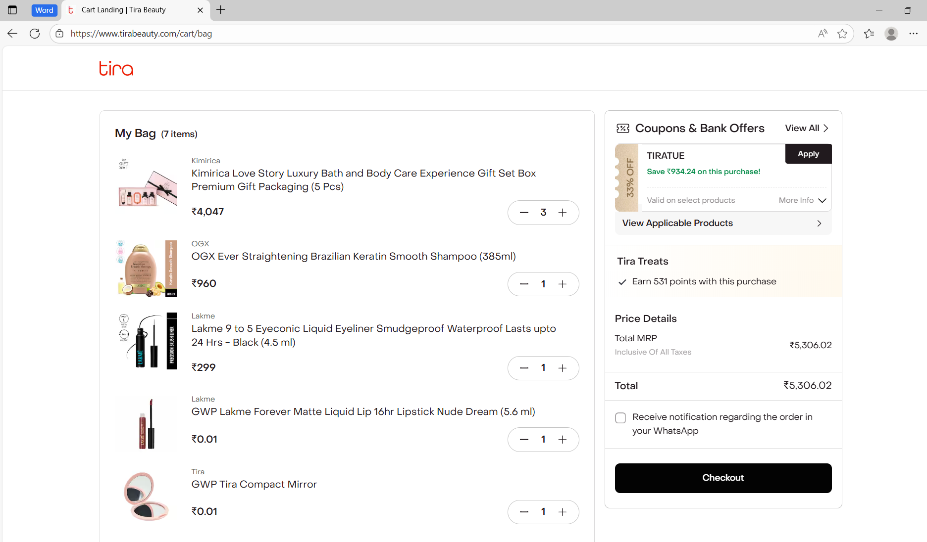
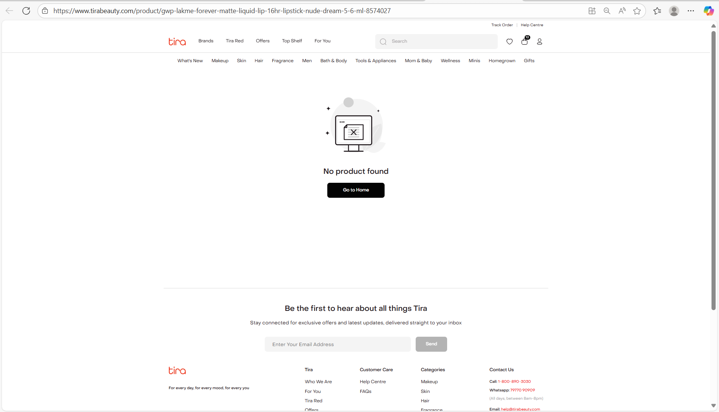

Slide 10
DEFECT IDENTIFIER:- B_002
Defect identifier :- B_002
Ø Defect summary :- Without login and email verification, the system is accepting invalid email IDs and allowing users to create tickets for queries. Expected output: Enter valid email or login first. Actual output: Accepting email and creating tickets
Ø Test Id :- TC_002
Ø Test case name :- TC_creating_tickets
Ø Module name :- Help center
Ø Reproducible :-
Ø Severity :- high
Ø Priority :- high
Ø Raised by :- Team lead
Ø Assigned to :- developer Team lead
Ø Date of assignment :- 08-08-2025
Ø Status :- pending
Ø Fixed by :- developer
Ø Date of fixing :-

Slide 11
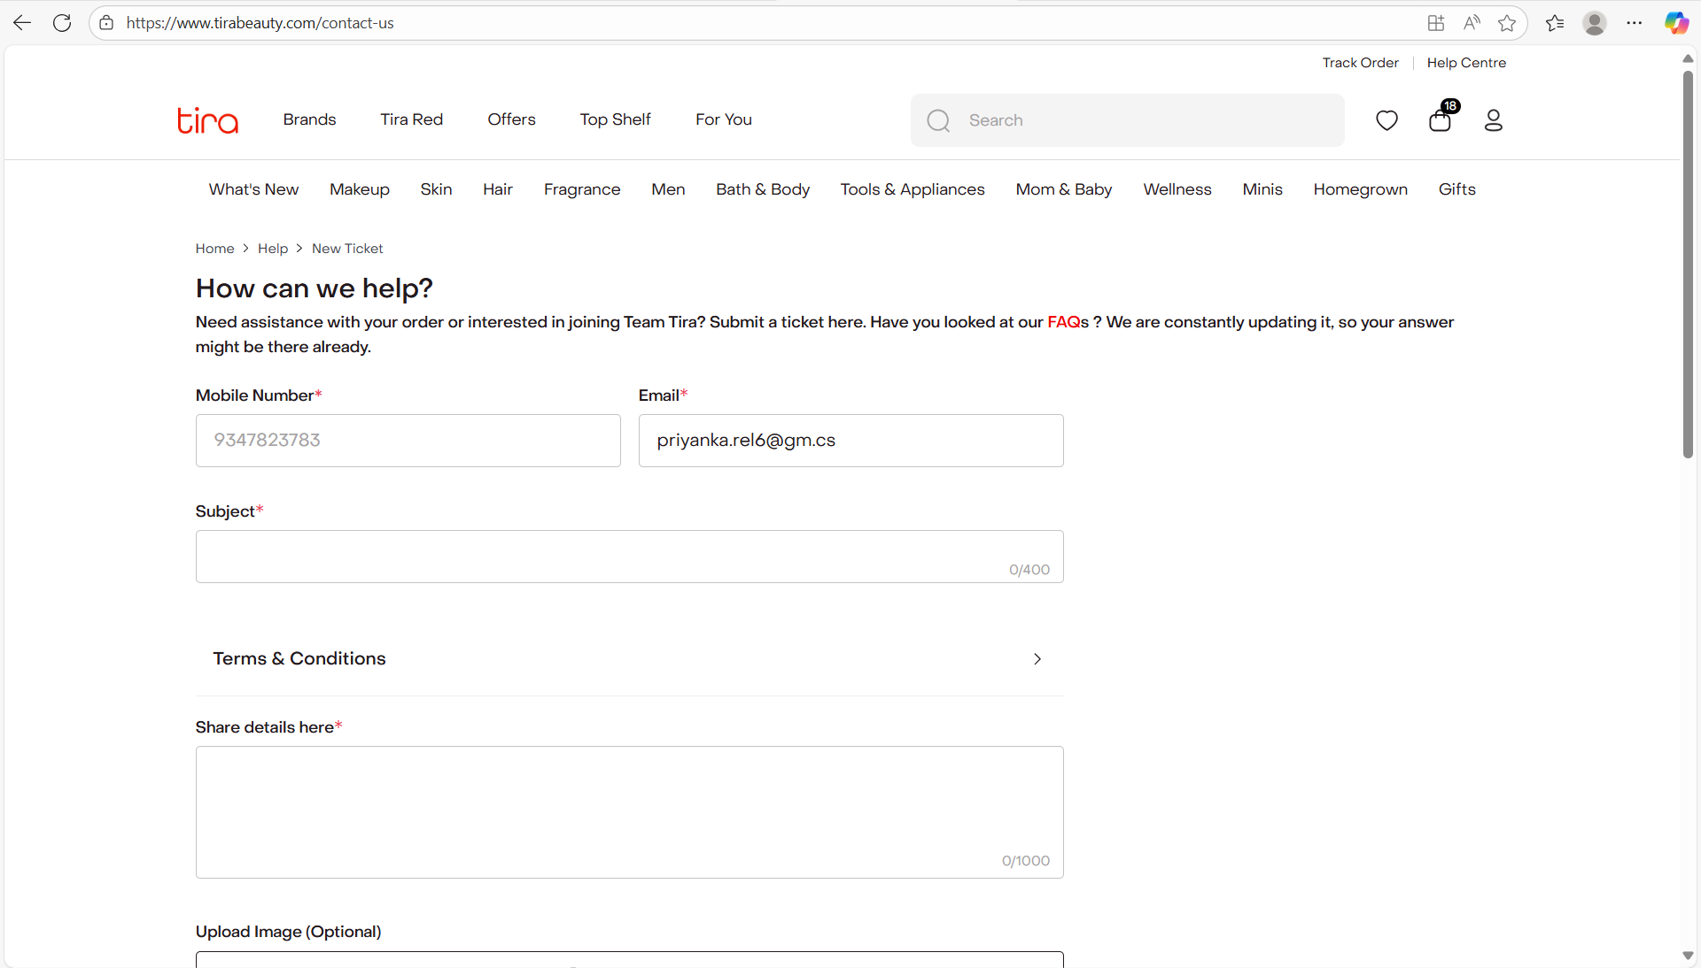
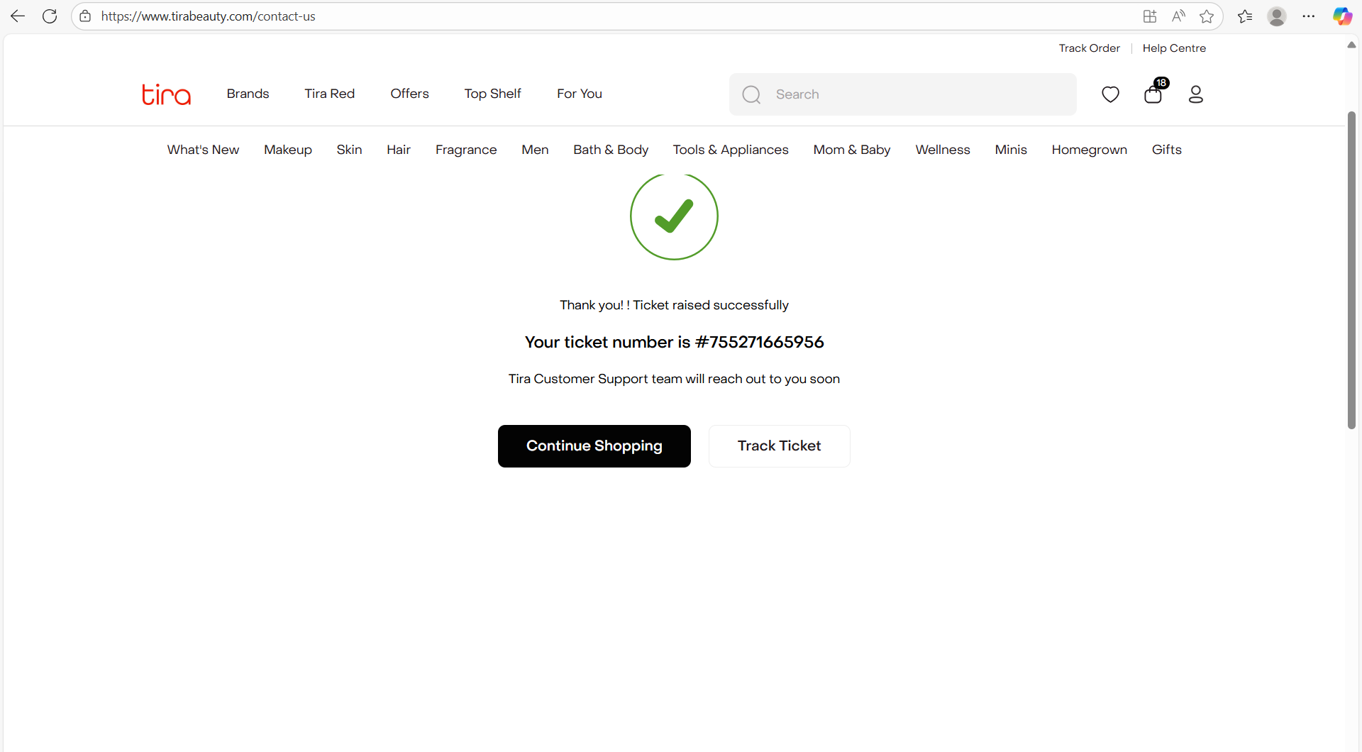

Slide 12
CHALLENGES
Handling Dynamic Content: One of the biggest challenges was handling dynamic content on the website, such as promotional banners and catalogs.
Since the OTP is sent to the user's phone, it can be difficult to automate login tests without manually entering the OTP each time.
In some cases, it's challenging to identify accurate XPaths for specific elements, such as:
- Brands submodules
- Offers submodules
There comes difference in writing a test case and executing them.

Slide 13
EXPERIENCE
Testing this e-commerce site has been a valuable learning experience, allowing me to acquire hands-on skills in Selenium automation and TestNG framework from scratch
Started by exploring the website, navigating through different sections
And then I found many bugs
I created automated test scripts using Selenium WebDriver to test the website's functionality, product search, and checkout. .

Slide 14
Thank You!!!
VAISHALI MAM For Guiding Us through out the Project

